Slide 1





Alton Infant School

Slide 2

PRINT AWARENESS
They are just a series of images and pictures to your child!
Ιφ ωε υσε τηε αλπηαβετ λεττερσ το λεαρν ηοω το ρεαδ ανδ ωριτε, ωε ωιλλ νεεδ λοτσ οφ πραχτισε ιν λοτσ οφ διφφερεντ ωαψσ.

Slide 3
Why teach phonics?
The ability to read and write well is a vital skill for all children, paving the way for an enjoyable and successful school experience.
Phonics helps children to develop good reading and spelling skills
e.g. cat can be sounded out for reading and spelling
We use a synthetic scheme called ‘Letters and Sounds’ as our teaching resource.

Slide 4


Why synthetic phonics?
“Synthetic phonics offers the vast majority of young children the best and most direct route to becoming skilled readers and writers”
Sir Jim Rose, Rose Review of Reading 2006
Synthetic phonics is simply the ability to change a letter or letter group into sounds that are then blended together into a word.
In other words synthesising (put together/build up) sounds and blend together to make a word.

Slide 5
Phonics at a glance
Phonics is…
Skills of segmentation and blending
Knowledge of the alphabetic code.

Slide 6

Definitions
A Phoneme:
This is the smallest unit of sound in a word and the sound that letter or group of sounds make………
How many phonemes/sounds can you hear in:
cat? shelf?

Slide 7

A grapheme
The written representation of a phoneme.
Children need to practise recognising the grapheme and saying the phoneme that it represents.
The grapheme could be 1 letter, 2 letters or more!
t ai igh

Slide 8
A phoneme you hear
A grapheme you see
A word always has the same number of phonemes and graphemes!

Slide 9
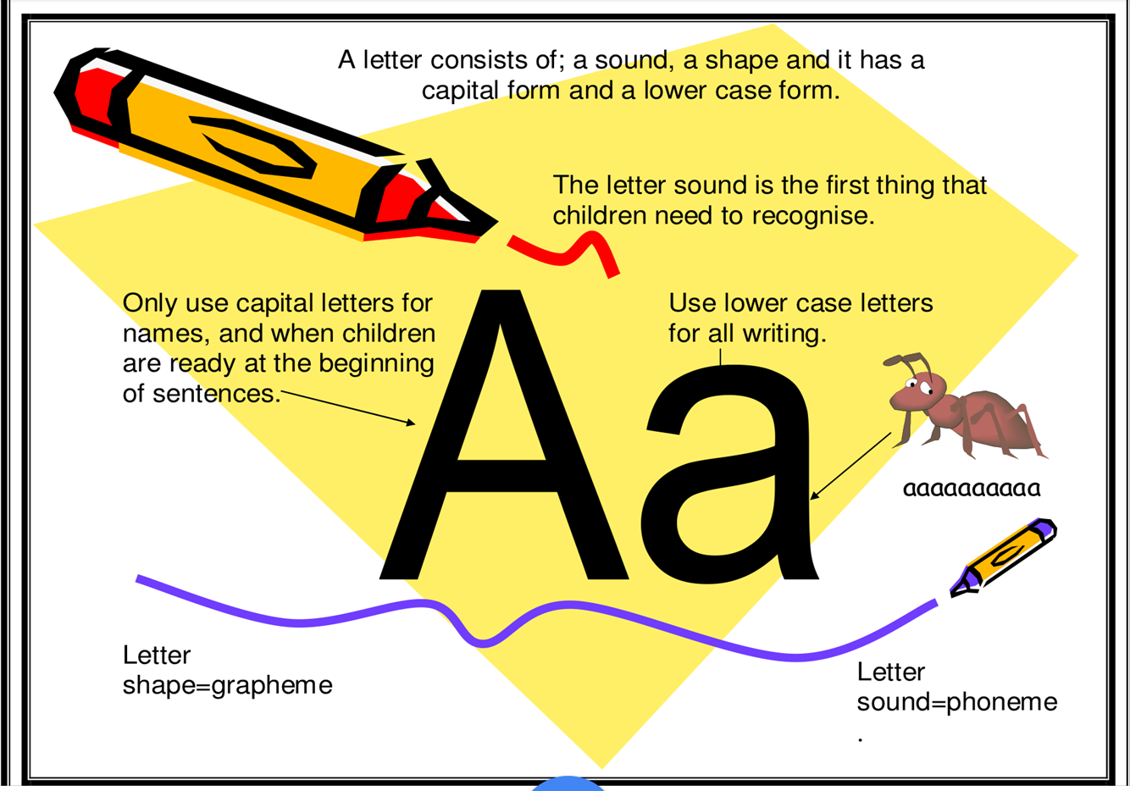

Slide 10
Letters and Sounds
Letters and Sounds is divided into six phases, with each phase building on the skills and knowledge of previous learning. Children have time to practise and rapidly expand their ability to read and spell words. They are also taught to read and spell ‘tricky words’, which are words with spellings that are unusual.

Slide 11
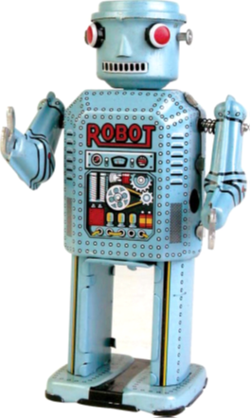
Phase 2 - Reception
In this phase children will continue practising what they have learned from phase 1, including ‘sound-talk’. They will also be taught the phonemes (sounds) for a number of graphemes (letters):
s a t p i n d g o c k ck m n e r u h b l f
ll ff ss
This phase teaches blending to read & segmenting to spell.

Slide 12
How to say the sounds
Saying the sounds correctly with your child is extremely important
The way we say sounds may well be different from when you were at school – please play video embedded within the next slides.
We say the shortest form of the sounds

Slide 13

The 44 phonemes
/b/ | /d/ | /f/ | /g/ | /h/ | /j/ | /k/ | /l/ | /m/ | /n/ | /ng/
/p/ | /r/ | /s/ | /t/ | /v/ | /w/ | /y/ | /z/ | /th/ | /th/ | /ch/
/sh/ | /zh/ | /a/ | /e/ | /i/ | /o/ | /u/ | /ae/ | /ee/ | /ie/ | /oe/
/ue/ | /oo/ | /ar/ | /ur/ | /au/ | /er/ | /ow/ | /oi/ | /air/ | /ear/ | /ure/

Slide 14
This is where it gets tricky!
Phonemes are represented by graphemes. Children have to learn the grapheme to know the sound.
A grapheme can consist of 1, 2 or more letters.
A phoneme can be represented/spelled in more than one way ( cat, kennel, choir)
The same grapheme may represent more than one phoneme ( me, met)

Slide 15
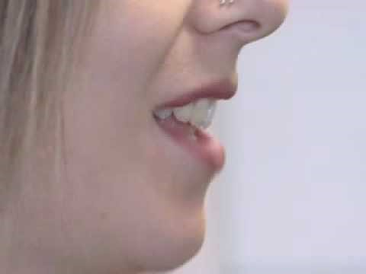
Movie time – Correct pronunciation
We talk about the shape of the mouth when producing the sound to the children
1 letter –grapheme = 1 sound
2 letters – digraph = 1 sound
3 letters – trigraph = 1 sound https://www.youtube.com/watch?v=BqhXUW_v-1s

Slide 16
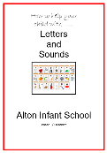
Let’s start at the beginning
Daily Phonics – Reception
Phase 2
The letters are not introduced in alphabetical order. The first group (s,a,t,i,p,n) has been chosen because they make more simple three-letter words than any other six letters.
You have received a sound booklet including all actions and picture clues. It is really important to regularly go over this.
Little and often helps. The sound mat is also in the front of the reading booklet – link this together when reading with your child.

Slide 17
Sound Order – Phase 2
Set 1: s, a, t, p
Set 2: i, n, m, d
Set 3: g, o, c, k
Set 4: ck, e, u, r
Set 5: h, b, f, ff, l, ll, ss

Slide 18
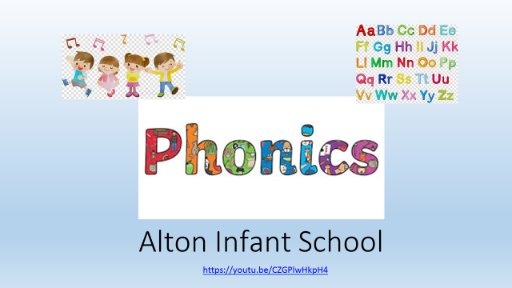
Alton Infant School Phonic Song
Help teach the phonic sounds linking to the picture clues on the sound mats. This will be downloaded onto Class dojo.

Slide 19
Blending
Recognising the letter sounds in a written word, for example
c-u-p
and merging or ‘blending’ them in the order in which they are written to pronounce the word ‘cup’

Slide 20
Segmenting
‘Chopping Up’ the word to spell it out
The opposite of blending
Identifying the individual sounds in a spoken word (e.g. h-i-m , s-t-or-k) and writing down letters for each sound (phoneme) to form the word him and stork

Slide 21





Blending and segmenting
c a t
Phoneme frames
cat

Slide 22

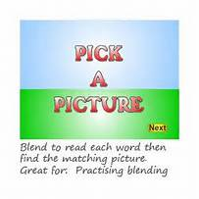

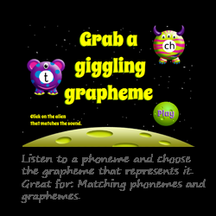
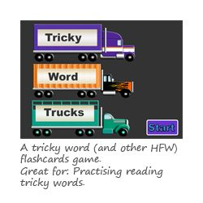


Phonics Play
Subscription Type
Individual £12 inc VAT for one year
This subscription allows one user to access the site.

Slide 23
Tricky Words
Words that are not phonically decodable
e.g. to, the, I
Some are ‘tricky’ to start with but will become decodeable once we have learned the harder phonemes (Phase 3/5)
e.g. out, there,

Slide 24
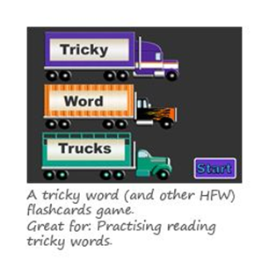
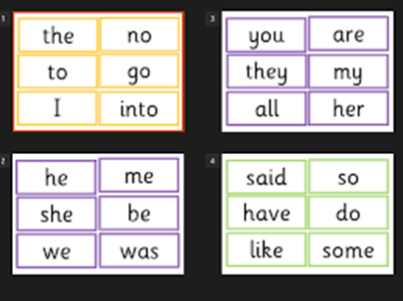
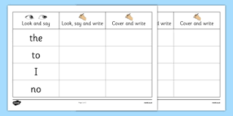
Words that are not phonically decodable – Phase 2
In order to write these words down, your child should also be taught the letter names from the alphabet.
I go no to the

Slide 25
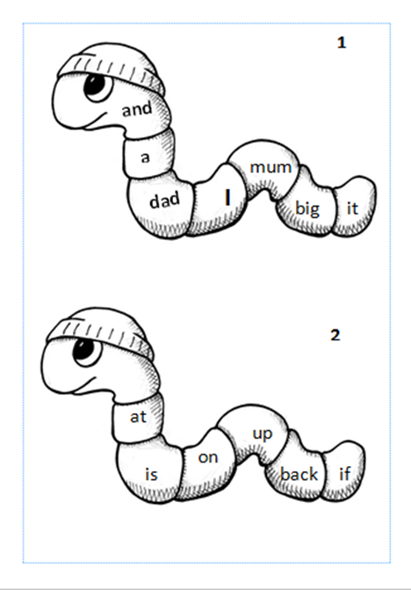
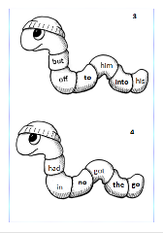
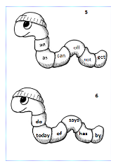
BUG WORDS
Worms – Phase 2
Once your child has mastered using their phonics, Your children will not need to sound out every word, this becomes long and tedious. These words can then be learnt by sight. These are called High Frequency words including ‘Tricky Words.’. They are fundamental to helping your child read more fluently. It is a good idea to learn these as a whole word to allow your child pace and enjoyment in reading.

Slide 26
Lesson format
In each year group, phonic lessons follow the same format:
Revise: The children will revise previous learning.
Teach: New phonemes or high frequency or tricky words will be taught.
Practice: The children will practise the new learning by reading and/or writing the words.
Apply: The children will apply their new learning by reading or writing sentences.
Notes:
From Foundation Stage 2 to Year 3 all phonics lessons follow this format

Slide 27
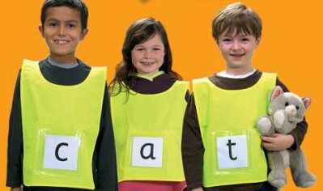
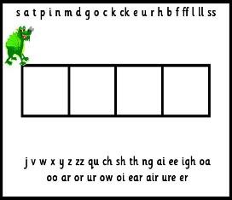
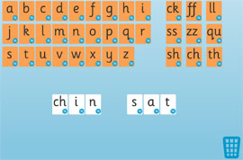
Phonic learning is fun!
The children learn and practise their phonemes in lots of fun ways:
Sound talking and rhyming.
Playing games – table games or interactive games on the computer.
Using phoneme frames, “sound buttons” and whiteboards to spell words.
Sorting phonemes.
Making words with phonemes.
Being phoneme “detectives”.
Reading and writing sentences. Silly sentences are great fun!
Notes:
Sequence in lesson of revisit/revise, teach, practise, apply

Slide 28
Phase 3 - Reception
The purpose of this phase is to:
  teach more graphemes, most of which are made of two letters, for example, ‘oa’ as in boat
  practise blending and segmenting a wider set of CVC words, for example, fizz, chip, sheep, light
  learn all letter names and begin to form them correctly
  read more tricky words and begin to spell some of them
  read and write words in phrases and sentences.

Slide 29
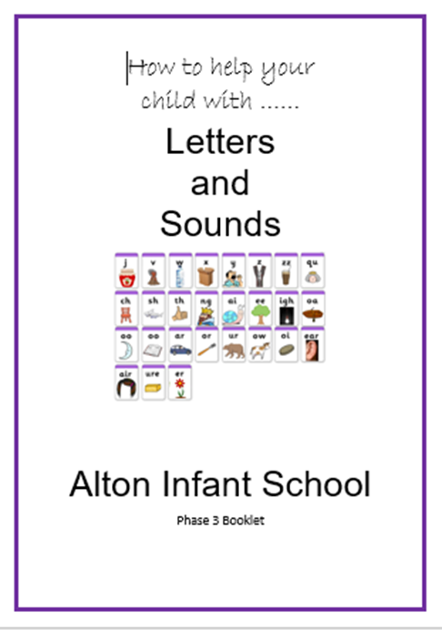
Sound Order – Phase 3
Set 6: j, v, w, x
Set 7: y, z, zz, qu
Consonant digraphs: ch, sh, th, ng
Vowel digraphs: ai, ee, igh, oa, oo, ar, or, ur, ow, oi, ear, air, ure, er

Slide 30
Words that are not phonically decodable – Phase 3
he she we
be me
you are her was all
they my

Slide 31
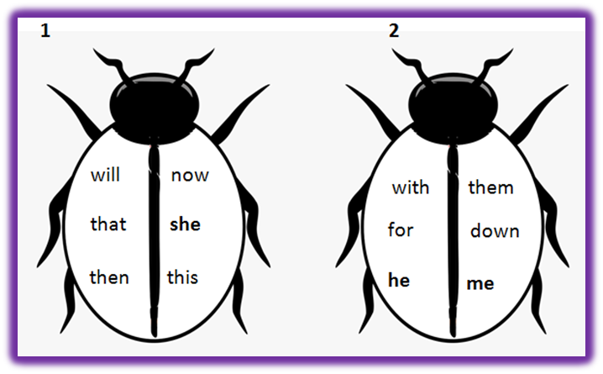
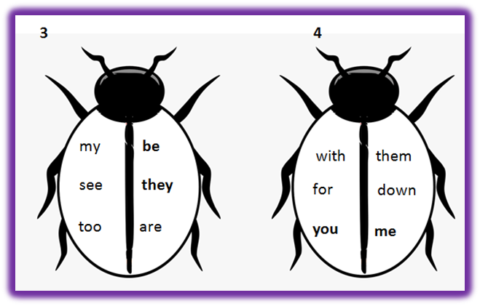
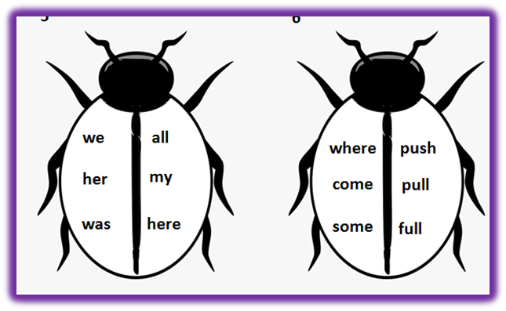
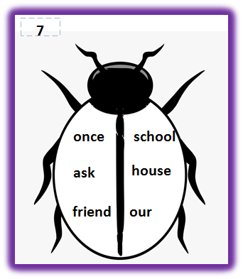
Ladybird words – High frequency including those tricky words – Set two – phase 3

Slide 32
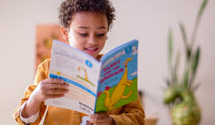
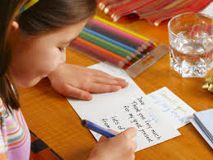
Phase 4 – Reception/Year 1
Children continue to practise previously learned graphemes and phonemes and learn how to read and write:
No further sounds taught at this phase.
Reading & spelling words containing adjacent consonants e.g. crunch, float, groan.
CVCC words: tent, damp, toast, chimp
For example, in the word ‘toast’, t = consonant, oa = vowel, s = consonant, t = consonant.
and CCVC words: swim, plum, sport, cream,
spoon
Reading & spelling two syllable words
Learning some tricky words:
Tricky words
said, so, do, have, like, some, come, were, there, little, one, when, out, what

Slide 33
How can I help?
Sing an alphabet song together
Play ‘I spy’
Continue to play with magnetic letters, using some two-grapheme (letter) combinations, eg: r-ai-n = rain blending for reading
rain = r-ai-n segmenting for spelling
Praise your child for trying out words
Look at tricky words
Look for phonic games
Play pairs with words and pictures

Slide 34
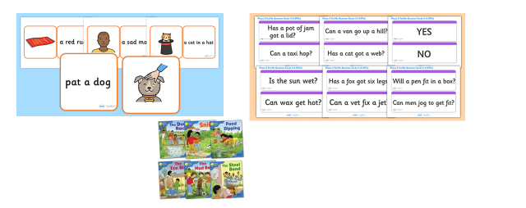
End of Year Expectation
Children read and understand simple sentences.
They use phonic knowledge to decode regular words and read them aloud accurately.
They also read some common irregular words.
They demonstrate understanding when talking with others about what they have read.
Children should know all Phase 2 and Phase 3 phonic sounds.

Slide 35
REMEMBER: Phonics is not the only thing needed to become a fluent reader.
Please continue to read with your child each night and encourage them to:
Sound out
Re-read to check it makes sense.
Use pictures for clues.
Ask questions about the book.
And most importantly ENJOY READING!
“Children fall in love with books because of the memories created when they snuggle up and read with someone they love.” – Raising readers

Slide 36




Useful website addresses and apps www.phonicsplay.co.uk www.oxfordowl.co.uk www.bbc.co.uk/cbeebies/shows/alphablocks www.teachyourmonstertoread.com/

Slide 37
Remember…..
“The more that you read, the more things you will know. The more that you learn, the more places you'll go.”
― Dr. Seuss, I Can Read With My Eyes Shut!

