Slide 1


Alton Infant School
We believe that every child deserves a happy, safe and stimulating environment that inspires them to become confident, caring and independent learners.
We are committed to helping your child
be the best they can be.

Slide 2
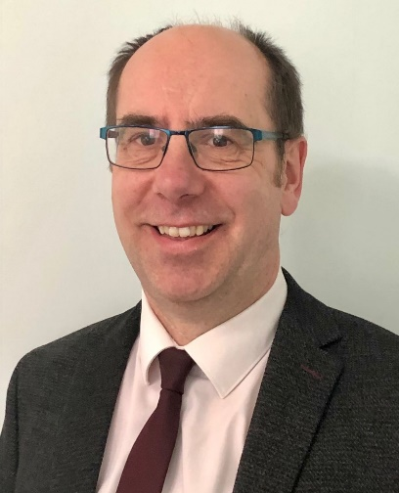
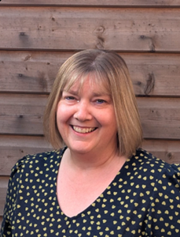
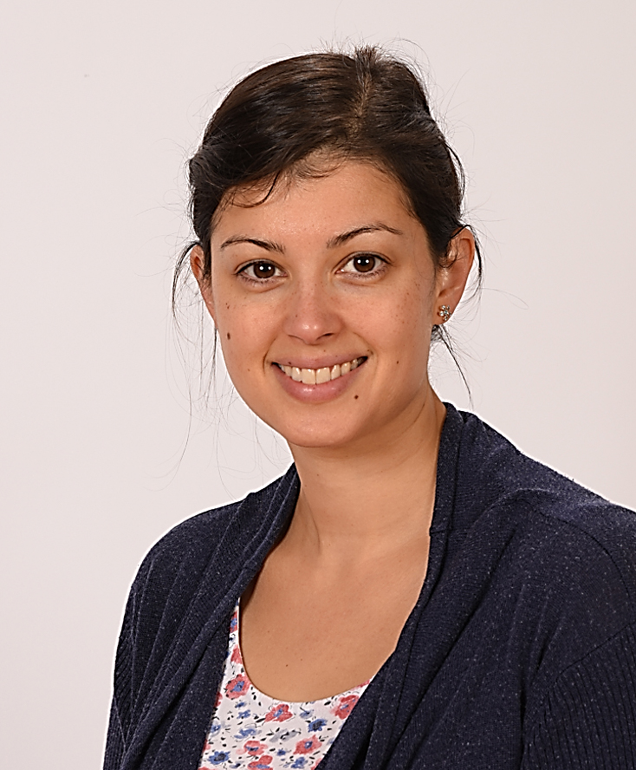
WELCOME Mr Richard Mead
Headteacher
Mrs Karen Cooper
Early Years Leader
Mrs Hill-Venning
SENCO

Slide 3


Welcome
Mrs Serdet
Headteacher from September 2026

Slide 4
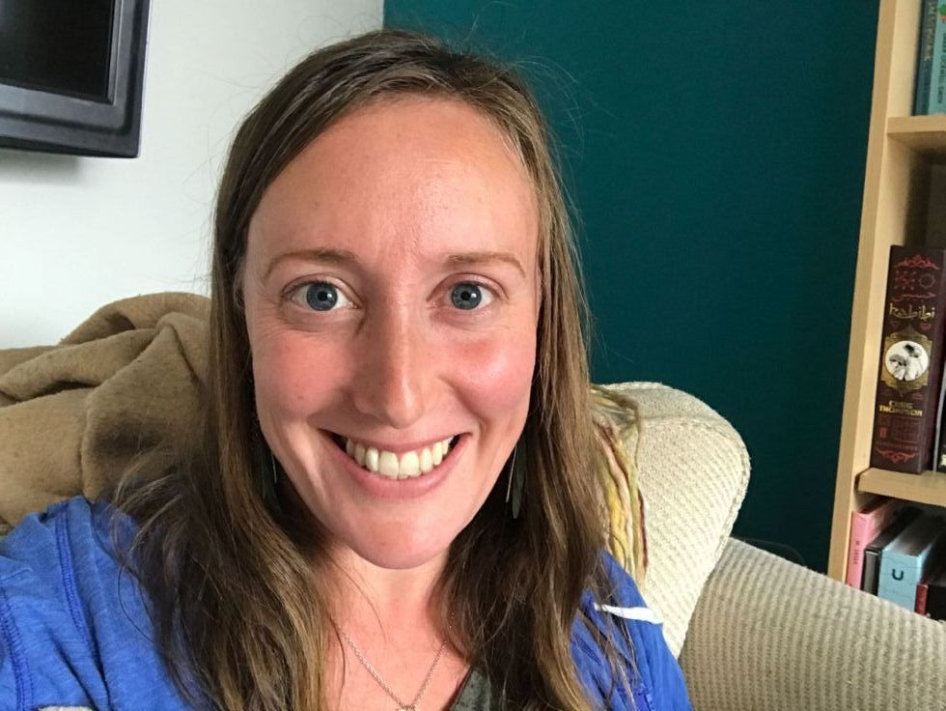
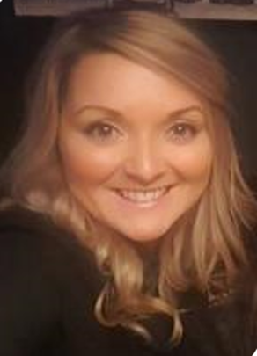
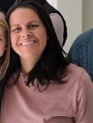

WELCOME
Vice-Chair of Governors
Safeguarding Governor
Roisin Pope
Chair of Governors
Early Years Governor

Slide 5



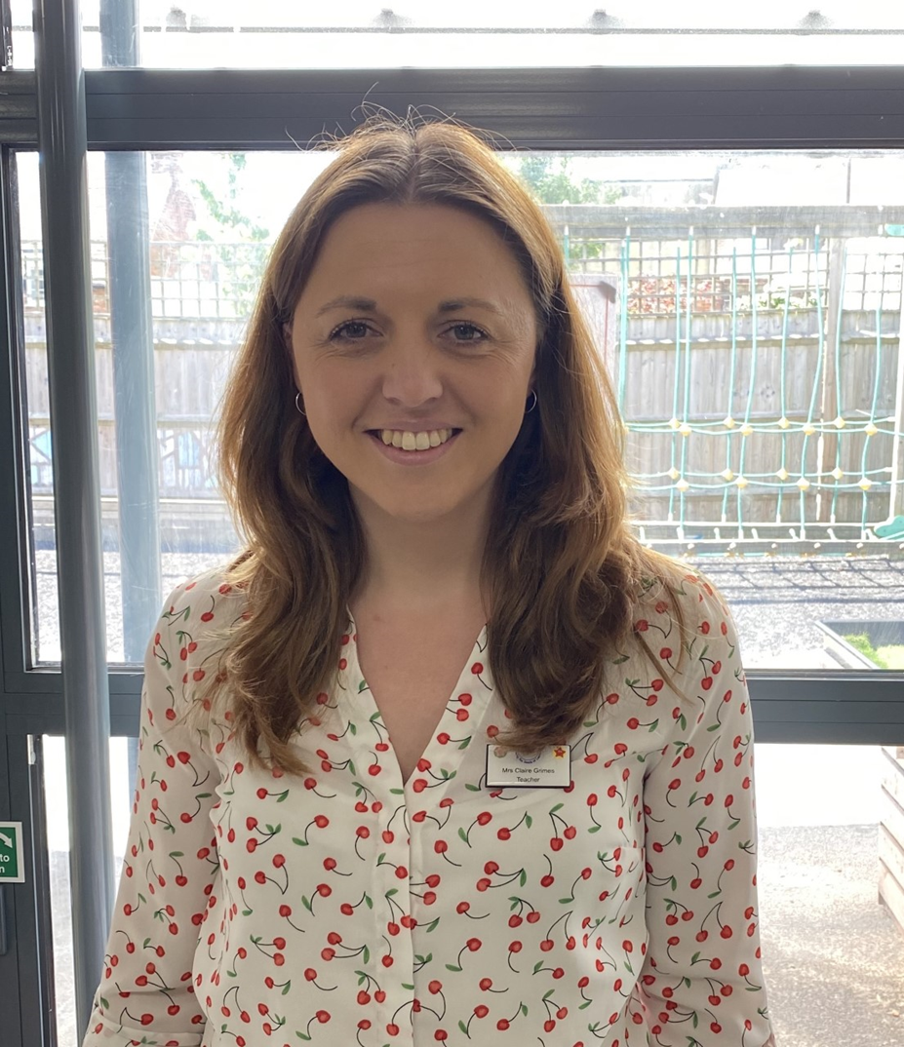

Year R Team
Mrs Cooper : Early Years Leader
Willow Class Teacher
Mrs Grimes: Elm Class Teacher

Slide 6

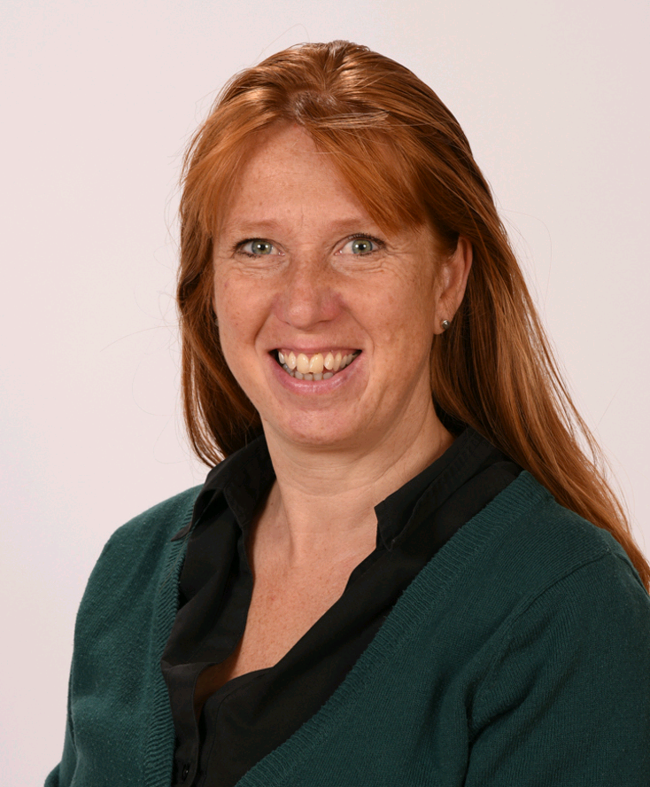
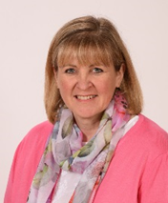
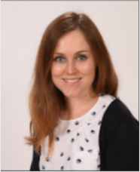
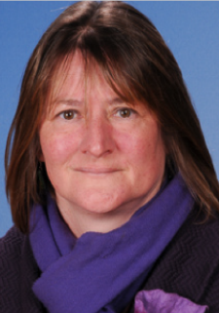
Year R Team
Mrs Tigwell – Higher Level Teaching Assistant
Mrs Pelling – Teaching Assistant & ELSA
Mrs Peacock- Higher Level Teaching Assistant
Mrs Stone – Teaching Assistant

Slide 7





Timeline
Confirmation of place made via visiting school
office with documentation.
Welcome letter received via email.
Opportunity to look at information on Website.
An Information pack – Collect tonight
‘Stay and play’ sessions – Dates in information pack

Slide 8

Transition into school
A positive, well-planned transition into reception helps children feel safe and confident to continue their learning. It supports communication and language development, social and emotional wellbeing, and positive engagement with learning. For some children, reception is their first sustained experience of an education setting, making the quality of transition arrangements particularly critical. Strong transitions enable children to make the most of the vital early weeks in reception, laying strong foundations for future success.

Slide 9



Transition into school
3 key themes to be prioritised working closely with families, building strong partnerships with early years settings and identifying needs early.
Transfer of professional knowledge
Visits to pre-schools settings by child’s new class teacher to meet the children in a safe and familiar place
Information sharing with pre-school

Slide 10
Transition into school
Parents
A crucial part of transition is for us to help our new parents and carers understand what school readiness looks like in practice. We hope this gives clarity and reassurance about what their child needs to thrive.
When we share our expectations are clearly and early, we hope parents feel empowered to support their child’s development and feel more confident about the move into reception.

Slide 11
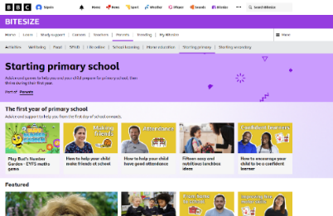
Parents supporting their children in transition
https://www.bbc.co.uk/bitesize/groups/cx1lpm3ve37t
(BBC Website)
Independence skills… Key skills:
Developing toilet training –wiping own bottoms/washing hands
Developing getting dressed and undressed
Responding to their names/ waiting their turn/recognising their name
Putting on own coat, shoes, hat and gloves

Slide 12



Parents supporting their children in transition
Asking for help when needed
Physical development – go to the park – run/hop/climb/scoot
Social interactions – park play dates
Following simple instructions
Reading to your children/playing games/Having conversations
Developing good bedtime routines – bath/story/ absolutely no iPads before its time for bed – interrupts their sleep patterns

Slide 13
Key Points for parents
Talk about school when conversations come up with your child
Attend the transition sessions offered by the school
‘Stay and Play’
Attend the ‘Lunchtime Visit’ with your child
Be organised – Return paperwork in pack

Slide 14





Stay and play sessions
Wednesday 17th June 2026 1:30 – 2:30 p.m.
Wednesday 24th June 2026 1:30 p.m. – 2:30 p.m.
Wednesday 8th July 2026 1:30 p.m. – 2:30 p.m
This is a great way for you and your child to meet new people and make new friends in a friendly, gentle and relaxed atmosphere.
The children will be able to play within the Year R environment both indoors and outdoors.
This will help prepare them for the transition into our school in September.
All Year R staff will be available to talk and answers any questions about the start of school.
We will have the uniform available to try on for size.
A display of ‘What you need to resource for your child ready for September’.
Meet our Home School Association and find out ways to get involved in supporting our school.
During the sessions, the children will receive a personal invitation to school.
A story will finish the last session read to them by their class teacher.

Slide 15



Come to Lunch Friday 3rd July
Arrive at 11:15 a.m. with your child
There will be a small amount of free time to play after lunch
We will sit in the school hall at 11:30 a.m. the dinner hatch will open
Please bring a pack lunch for you and your child
Sample food will be available for you and your child to try
Meet some lunchtime staff
We will finish with opportunities to share a story with your child
Year R team will also be available
Finish at 12:15 p.m.

Slide 16
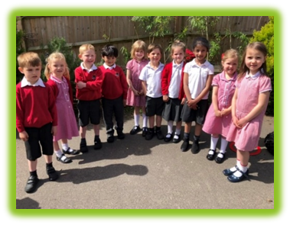

Uniform
This will be available to try on during the ‘Stay and play’ sessions.
This leaflet with ordering information is in your pack with the deadline date for September.
You will need to order bookbags through this site.

Slide 17




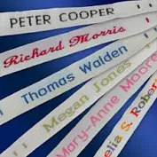


What to do over the Summer…
Practice journey to school
Ensure you have purchased all uniform and equipment/clothing needed:
School jumper/cardigan (RED)
Red P.E t.Shirt
Red school logo bookbag
School trousers/skirt (Grey/Black)
White polo shirt
Black P.E shorts
School shoes
Suitable water bottle
Label EVERYTHING – add a recognisable motif or one small key ring to help your child to take care of their own belongings
Independence skills
Keep good routines

Slide 18



Claire Ryan
Selena Brash

Slide 19








ADMISSION INTO SCHOOL-Mornings Only
All children will be starting school on
Wednesday 2nd September
Your child will be given a drop off time slot
Children will stay to lunch.
Children will be collected at on Wednesday 2nd, Thursday 3rd and Friday 4th at 1.15pm.

Slide 20





Greet and Meet in September
2nd/3rd/4th 1:30 p.m.– 4p.m.
Individual slots – Given to you at ‘Stay and Play’
These will be for around 15 minutes.
Opportunity to discuss you and your family’s needs.
Opportunity to ask questions.

Slide 21

Knowing your child….
Every child is an individual
Go at their pace
Meet their needs
Build good relationship with the new school
Don’t be afraid to ask for help or support

Slide 22


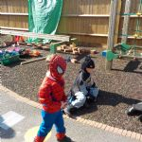
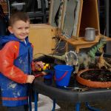
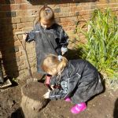
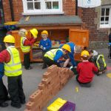
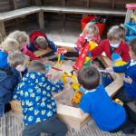
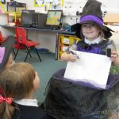
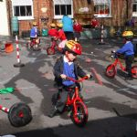
FULL TIME SCHOOL
ALL CHILDREN full time
Monday 7th September 2026
Side gate opens at 8.45 a.m.
Registration is taken at 8.55 a.m.
End of school 3:15 p.m.

Slide 23

Starting school
Beginning weeks
Our effective transition practice results in children feeling safe and motivated to return each day. We embed predictable routines, relationships and start introducing learning gradually, all at a pace children can manage, which supports a strong, equitable start to the reception year.

Slide 24


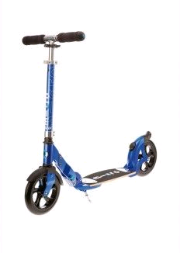




Travelling to school
Walking to school
Scootering to school
Driving to school
Arriving at the school gates: Please remember to move right along the front section of the school whilst waiting for the wooden gates to be unlocked at 8:40 a.m. as it can become very congested at peak times. Gates stay open till 8:55 a.m.

Slide 25



We provide Breakfast club in the our Community Room.
It runs from 7:45 – 8:45 a.m.
Children must arrive before 8:20 a.m. to be provided with a breakfast.
Each session is £6.00
Please book via our school office.

Slide 26


After School Club
Anstey Junior School provide after school provision until 5:45 p.m. £11:00 session
Walking Bus - Alton Infant School staff walk the children to Anstey.
Anstey Junior School Office 01420 84486

Slide 27


Home School Association
Staff, Parents and Friends
Together we raise funds to help the school provide the extra learning resources and activities for our children.
Coffee Mornings
Cake Bakes
School gardens
School Discos
Christmas Party
Run Quiz Nights
Barbecues

Slide 28



External Opportunities
These opportunities are run by outside companies.
You will need to book places
Beware some come with a cost £££££
School staff will not be present – social opportunity for children/parents
These opportunities have been emailed out by our school office
Sports centre - Local Alton Library

Slide 29






Things to do this evening
Have refreshments.
Pick up your named envelope.
Meet Staff, Governors and HSA
Take another opportunity to look in classrooms and Year R learning outdoor learning environment.
Plant a seed ‘ Sowing the seeds of learning’

Slide 30



Don’t forget to keep updated by logging on to our website for latest letters, photos and information:
https://www.alton-inf.hants.sch.uk/

Slide 31





Starting School Links
https://www.hants.gov.uk/librariesandarchives/kids-zone
https://hungrylittleminds.campaign.gov.uk/
https://www.booktrust.org.uk/books-and-reading/our-recommendations/best-books-for-0-5s/
https://speechandlanguage.info/parents
https://www.bbc.co.uk/bitesize/collections/starting-primary-school/1

Slide 32



Starting School Links
https://www.hants.gov.uk/educationandlearning/emtas/supportinglanguages/emtas-phone-lines
https://www.thinkuknow.co.uk/
https://www.hampshirehealthyfamilies.org.uk/chathealth

Slide 33





Children's links
https://www.bbc.co.uk/cbeebies/stories
https://www.bbc.co.uk/cbeebies/shows/alphablocks
https://home.oxfordowl.co.uk/at-school/early-years/
https://www.bbc.co.uk/cbeebies/shows/numberblocks
https://www.nationaltrust.org.uk/features/connecting-kids-with-nature

Slide 34









Slide 35

THANK YOU
If you have any further questions, please do not hesitate to call the school office on 01420 83857.

Slide 36


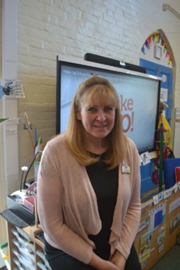
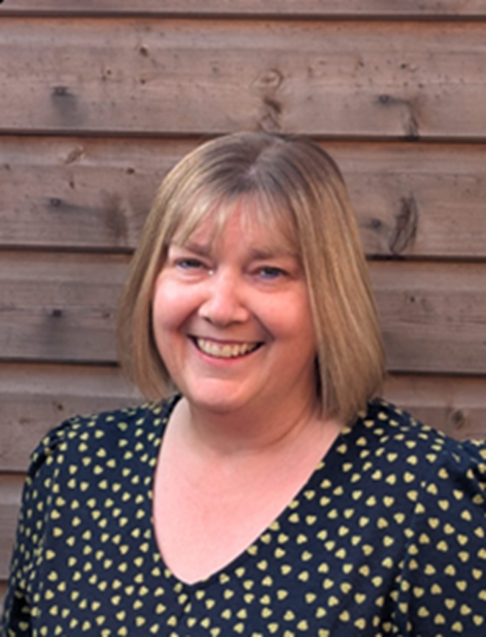
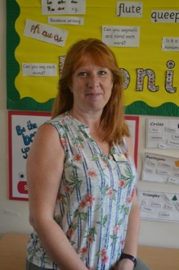

Mrs Pelling
Mrs Tigwell
Mrs Cooper

