Slide 1




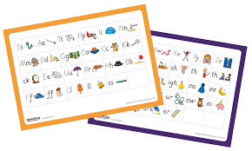
UNLOCKING LETTERS AND SOUNDS​

Slide 2
Unlocking letters and sounds
Introduction​
What is phonics?
How do we teach your children in EYFS?
What you can do to support at home.

Slide 3

They are just a series of images and pictures to your child!
Ιφ ωε υσε τηε αλπηαβετ λεττερσ το λεαρν ηοω το ρεαδ ανδ ωριτε, ωε ωιλλ νεεδ λοτσ οφ πραχτισε ιν λοτσ οφ διφφερεντ ωαψσ.

Slide 4

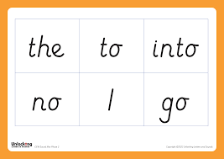
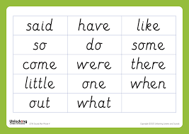
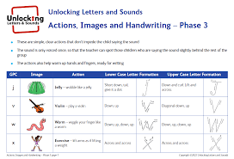
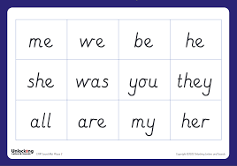
Why teach Phonics?
The ability to read and write well is a vital skill for all children, paving the way for an enjoyable and successful school experience.
Phonics helps children to develop good reading and spelling skills
e.g. cat can be sounded out for reading and spelling
We use a synthetic scheme called ‘ Unlocking Letters and Sounds’ as our teaching resource.

Slide 5
Why synthetic phonics?
Synthetic phonics is simply the ability to change a letter or letter group into sounds that are then blended together into a word.
In other words synthesising (put together/build up) sounds and blend together to make a word.

Slide 6
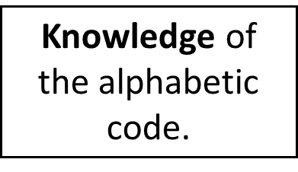
Phonics at a glance
Phonics is…
Skills of segmentation and blending

Slide 7
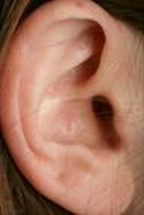
Definitions
A Phoneme:
This is the smallest unit of sound in a word and the sound that letter or group of sounds make………
How many phonemes/sounds can you hear in:
cat? shelf?

Slide 8
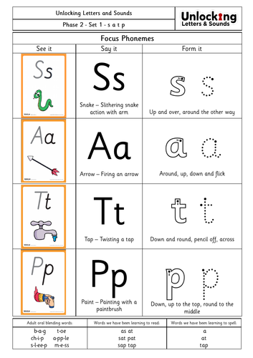


Definitions
A grapheme
The written representation of a phoneme.
Children need to practise recognising the grapheme and saying the phoneme that it represents.

Slide 9

SIMPLITCITY
A phoneme you hear
A grapheme you see

Slide 10
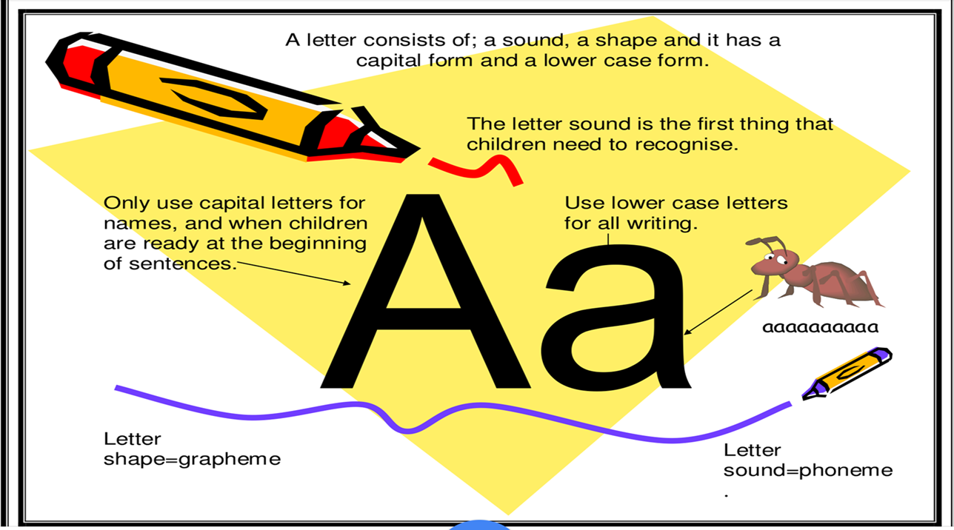

Slide 11
Unlocking Letters and Sounds
Unlocking Letters and Sounds is divided into five phases, with each phase building on the skills and knowledge of previous learning. Children have time to practise and rapidly expand their ability to read and spell words. They are also taught to read and spell ‘Common Exception words with tricky elements’, which are words with spellings that are unusual.

Slide 12
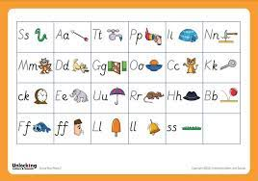
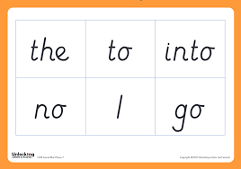
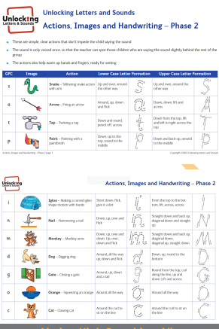
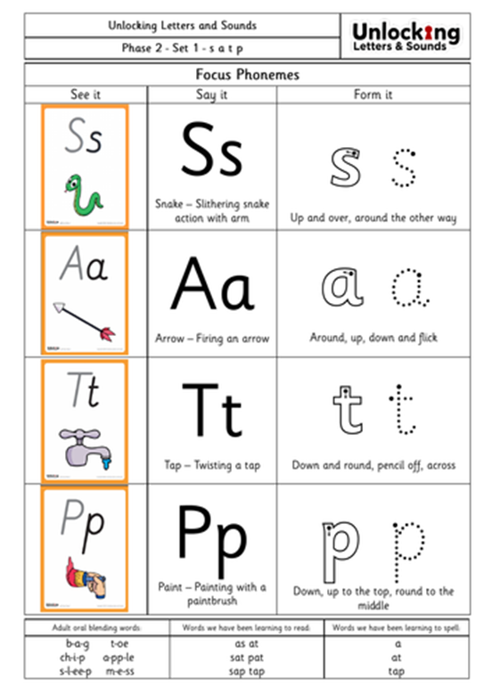

Phase 2 - Reception
In this phase children will continue practising what they have learned from phase 1, including ‘sound-talk’
They will also be taught the phonemes (sounds) for a number of graphemes (letters):
s a t p i n d g o c k ck m n e r u h b l f
ll ff ss
This phase teaches blending to read & segmenting to spell.

Slide 13
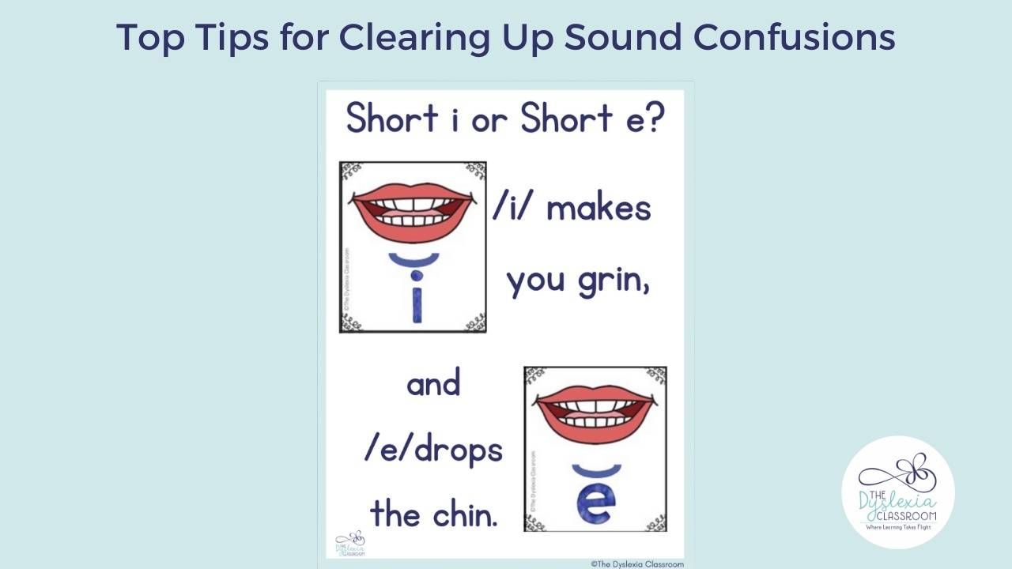
How to say the sounds
Why Teaching Mouth Placement is Important
Individual phoneme production is an integral part of reading and spelling instruction. Students need to be able to isolate phonemes to segment. The skill of segmenting is the ability to take apart individual phonemes, sounds, within words. Think of these as the parking spots for the letters that represent these sounds.
When we help students identify the placement of their mouth for individual sound production, we create a connection between what we are hearing and how that sound feels in our mouth.

Slide 14

44 Phonemes
/b/ | /d/ | /f/ | /g/ | /h/ | /j/ | /k/ | /l/ | /m/ | /n/ | /ng/
/p/ | /r/ | /s/ | /t/ | /v/ | /w/ | /y/ | /z/ | /th/ | /th/ | /ch/
/sh/ | /zh/ | /a/ | /e/ | /i/ | /o/ | /u/ | /ae/ | /ee/ | /ie/ | /oe/
/ue/ | /oo/ | /ar/ | /ur/ | /au/ | /er/ | /ow/ | /oi/ | /air/ | /ear/ | /ure/

Slide 15
This is where it gets tricky!
Phonemes are represented by graphemes. Children have to learn the grapheme to know the sound.
A grapheme can consist of 1, 2 or more letters.
A phoneme can be represented/spelled in more than one way ( cat, kennel, choir)
The same grapheme may represent more than one phoneme ( me, met)

Slide 16
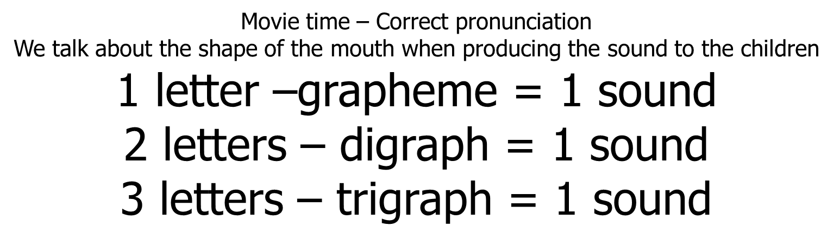
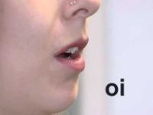
https://www.youtube.com/watch?v=BqhXUW_v-1s

Slide 17



Slide 18
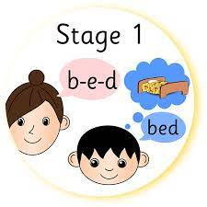

Blending
Recognising the letter sounds in a written word, for example
c-u-p
and merging or ‘blending’ them in the order in which they are written to pronounce the word ‘cup’

Slide 19
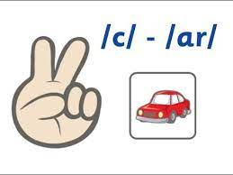

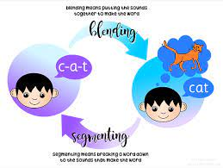
Segmenting
‘Chopping Up’ the word to spell it out
The opposite of blending
Identifying the individual sounds in a spoken word (e.g. h-i-m , s-t-or-k) and writing down letters for each sound (phoneme) to form the word him and stork

Slide 20
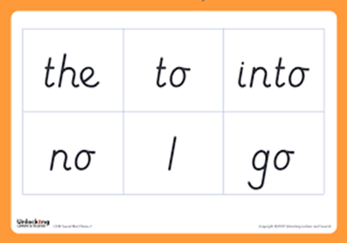
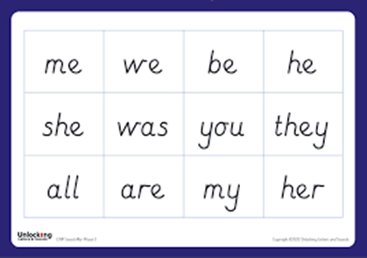
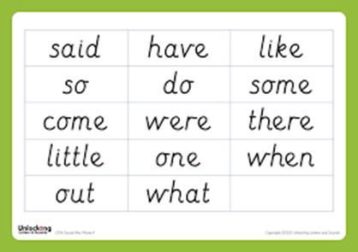
Common Exception Words
Words that are not phonically decodable
e.g. to, the, I, no, go, into

Slide 21

Lesson Format Please watch clip
In each year group, phonic lessons follow the same format:
Revise: The children will revise previous learning.
Teach: New phonemes or high frequency or tricky words will be taught.
Practice: The children will practise the new learning by reading and/or writing the words.
Apply: The children will apply their new learning by reading or writing sentences.

Slide 22
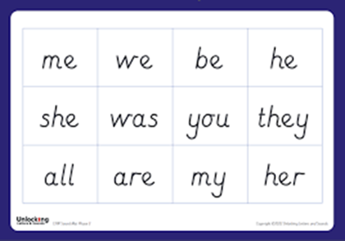
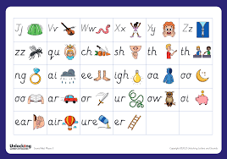
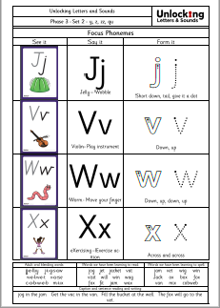
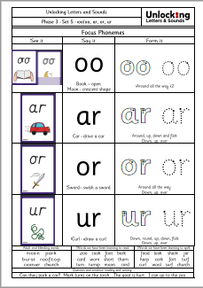
Phase 3 - Reception
The purpose of this phase is to:
  teach more graphemes, most of which are made of two letters, for example, ‘oa’ as in boat
  practise blending and segmenting a wider set of CVC words, for example, fizz, chip, sheep, light
  learn all letter names and begin to form them correctly
  read more common exception words and begin to spell some of them
  read and write words in phrases and sentences.

Slide 23
Phase 4
Children continue to practise previously learned graphemes and phonemes and learn how to read and write:
No further sounds taught at this phase.
Reading & spelling words containing adjacent consonants e.g. crunch, float, groan.
CVCC words: tent, damp, toast, chimp
For example, in the word ‘toast’, t = consonant, oa = vowel, s = consonant, t = consonant.
and CCVC words: swim, plum, sport, cream,
spoon

Slide 24
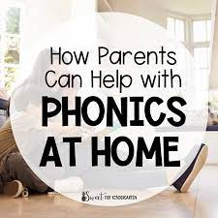
How can I help?
Sing an alphabet song together
Play ‘I spy’
Continue to play with magnetic letters, using some two-grapheme (letter) combinations, eg: r-ai-n = rain blending for reading
rain = r-ai-n segmenting for spelling
Praise your child for trying out words
Look at common exception words
Look for phonic games
Play pairs with words and pictures

Slide 25

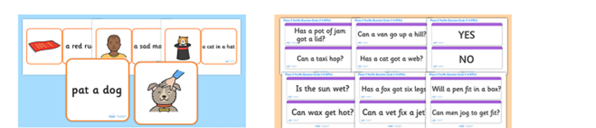
End of Year Expectation
End of Year Expectation
Children read and understand simple sentences.
They use phonic knowledge to decode regular words and read them aloud accurately.
They also read some common irregular words.
They demonstrate understanding when talking with others about what they have read.
Children should know all Phase 2 and Phase 3 phonic sounds.
(Phase 3 – At least 10 digraphs – Early learning goal)

Slide 26




ADDITIONAL LINKS
Website addresses and apps
www.unlocking letters and sounds letters and sounds
www.phonicsplay.co.uk
www.oxfordowl.co.uk
www.bbc.co.uk/cbeebies/shows/alphablocks
www.teachyourmonstertoread.com/

Slide 27
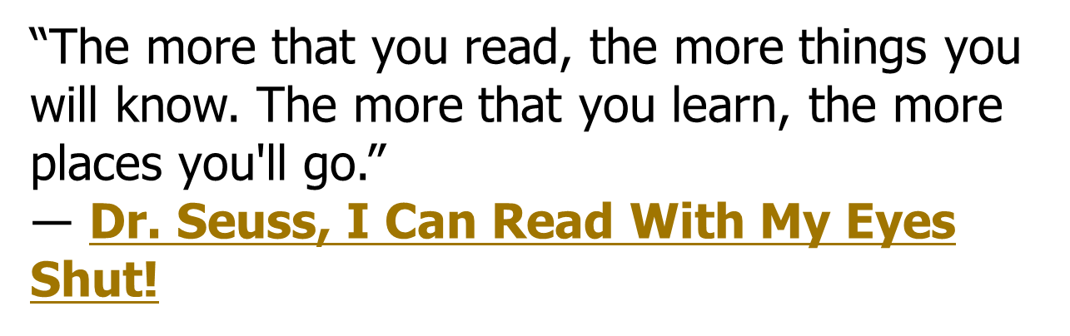

REMEMBER

